Slide 1
Design Patterns in C#
Orlando Campos Pasten

Slide 2
Introduction
Are solutions to software design problems you find again and again in real-world application development.
Patterns are about reusable designs and interactions of objects.
Is a general repeatable solution to a commonly occurring problem in software design.

Slide 3
Categories
Design Patterns
Creational
Structural
Behavioral

Slide 4
Purpose by category
Creational
Are patterns that deal with object creation mechanisms, trying to create objects in a manner suitable to the situation.
Structural
Are patterns that ease the design by identifying a simple way to realize relationships between entities.
Behavioral
Identify common communication patterns between objects and realize these patterns. By doing so, these patterns increase flexibility in carrying out this communication.

Slide 5
Categories
Creational
Abstract Factory
Builder
Structural
Adapter
Bridge
Behavioral
Factory Method
Prototype
Singleton
Composite
Decorator
Façade
Flyweight
Proxy
Chain of Resp.
Command
Interpreter
Iterator
Mediator
Memento
Observer
State
Strategy
Template method
Visitor

Slide 6
Observer Pattern
Behavioral
Orlando Campos Pasten

Slide 7
Observer pattern: Intent
Define a one-to-many dependency between objects so that when one object changes state, all its dependents are notified and updated automatically.
Encapsulate the core (or common or engine) components in a Subject abstraction, and the variable (or optional or user interface) components in an Observer hierarchy.
The "View" part of Model-View-Controller.

Slide 8
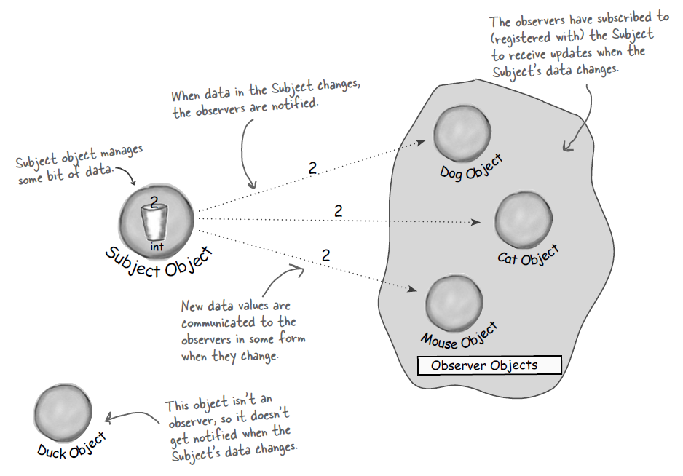
Graphical example

Slide 9
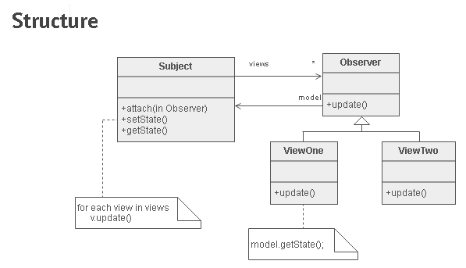
Observer pattern: Structure
Example 1

Slide 10
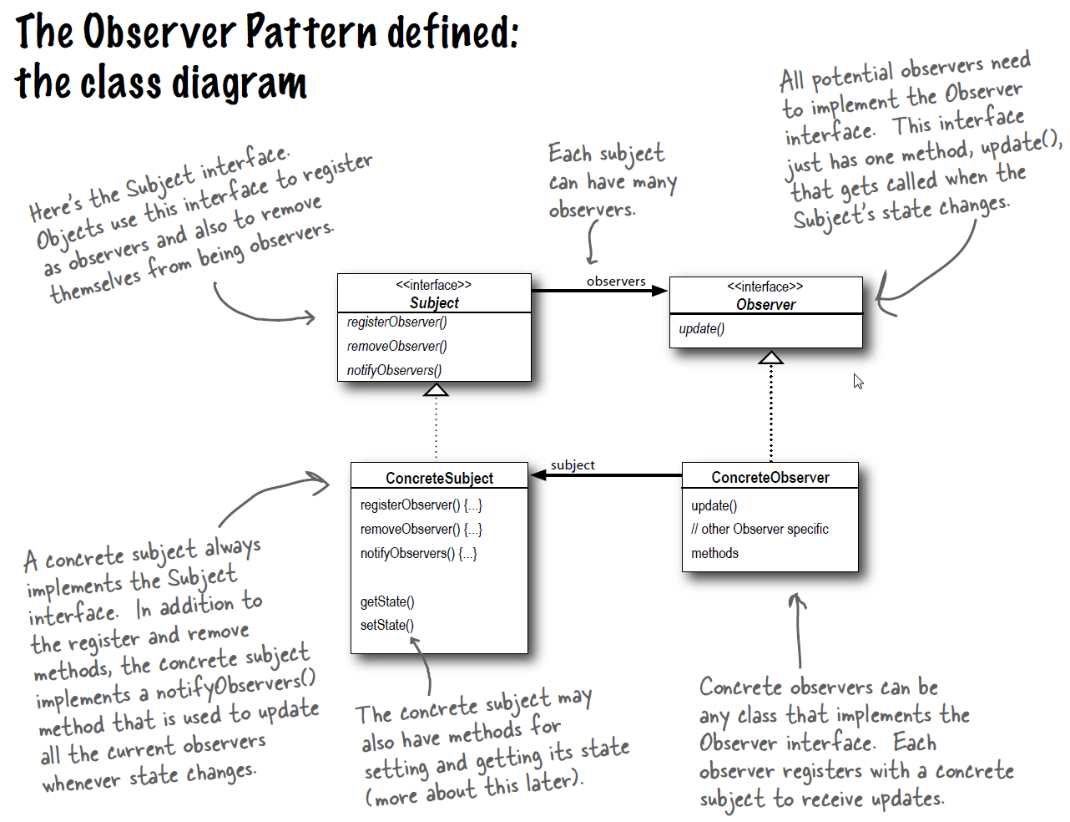
Observer pattern: Structure
Example 2

Slide 11
Observer pattern: Practice
A person has an account in a bank.
A person registers his cellphone to receive notifications from the bank.
The bank system sends a notification once a person account has received a money credit.
A person can unregister his cellphone for stop receiving notifications.
Example 2

Slide 12
Decorator Pattern
Structural
Orlando Campos Pasten

Slide 13
Decorator pattern: Intent
Attach additional responsibilities to an object dynamically. Decorators provide a flexible alternative to subclassing for extending functionality.
We wrapp objects to give them new responsibilities
Client-specified embellishment of a core object by recursively wrapping it.
Client-specified embellishment of a core object by recursively wrapping it.

Slide 14
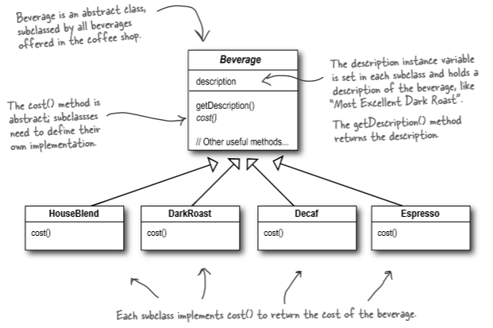
Example: Initial design
Coffee shop

Slide 15
Example: Initial design
Now we want to let the system add some “condiments” like Mocha, Soy or Steamed Milk.
How would you solve it?

Slide 16
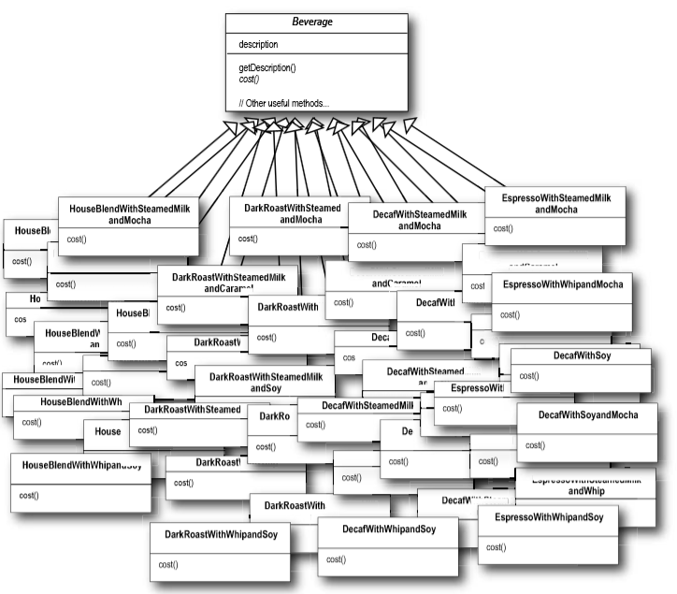
Example: Solution 1

Slide 17
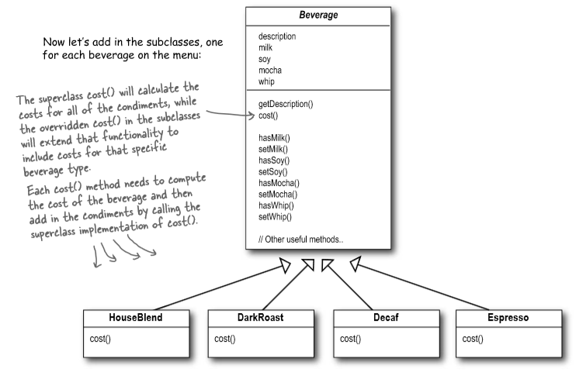
Example: Solution 2

Slide 18
Example: Analysis for solution 1 and 2
Solution 1:
Class explosión
Inheritance for replicating the behavior is not the solution.
Solution 2:
Every time you want to add a new condiment you should touch the base class.
If you want to modify a condiment Price you will need to alter the code.

Slide 19
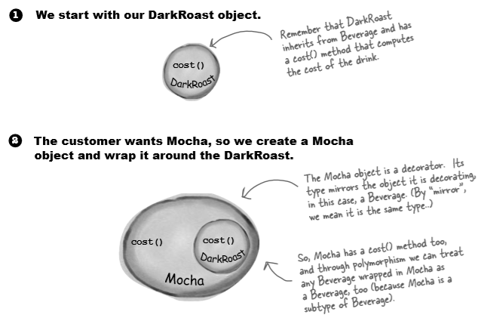
Graphical example

Slide 20
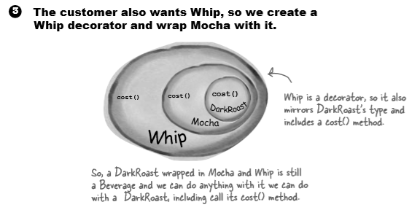
Graphical example

Slide 21
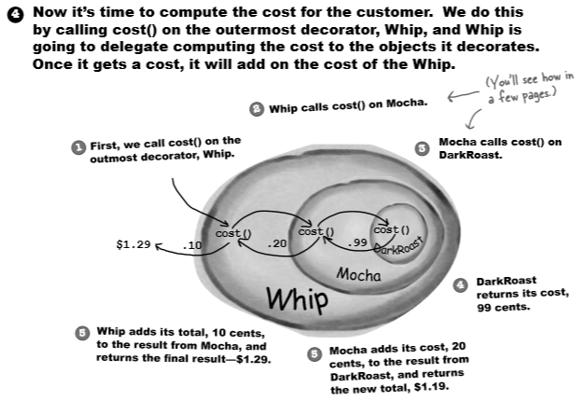
Graphical example

Slide 22
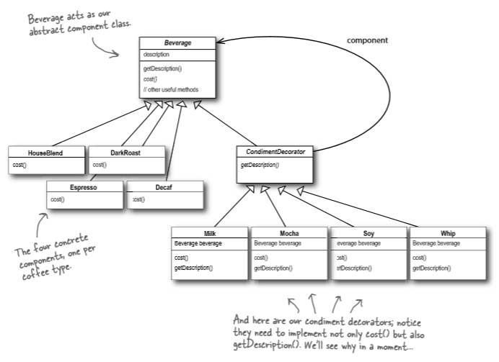
Example: Final solution

Slide 23
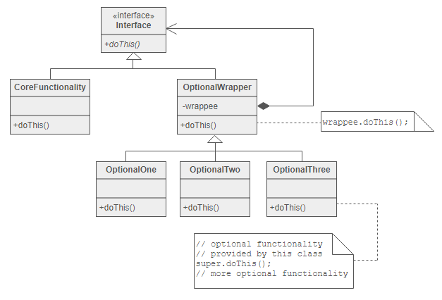
Decorator pattern: Structure

Slide 24


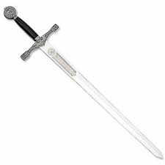
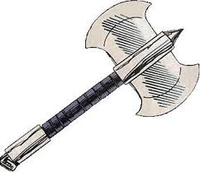


Game character’s armor
Decorator pattern: Practice
Dwarf armor
Elf armor
Sword
P = 5
A = 4
S = 10
P = 5
A = 10
S = 4
Axe
Strength
Precision + 2
Agility
Human armor
Bow and arrow
Strength + 2
P = 10
A = 5
S = 4
S=Strength
A=Agility
P=Precision
Agility + 2
Precision

Slide 25
Factory method
Creational
Orlando Campos Pasten

Slide 26
Factory method pattern: Intent
Define an interface for creating an object, but let subclasses decide which class to instantiate.
Factory Method lets a class defer instantiation to subclasses.

Slide 27
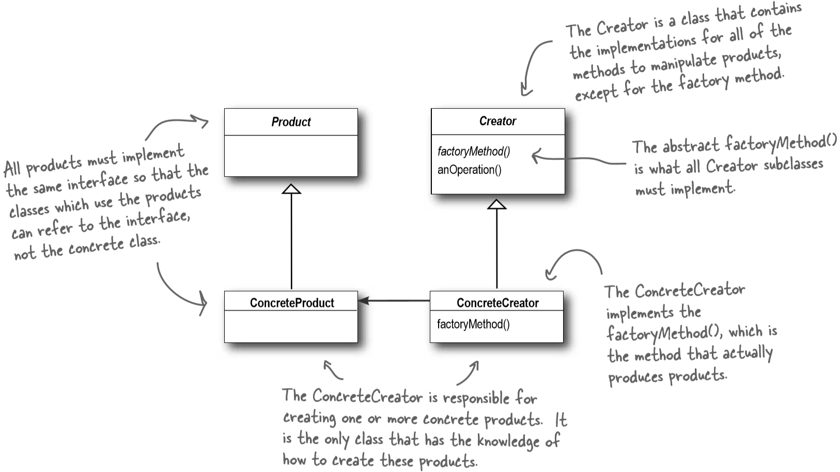
Factory method

Slide 28
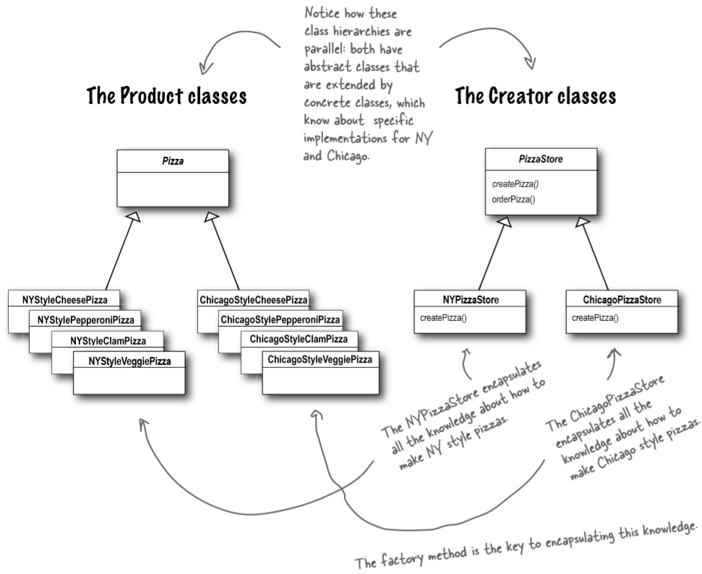
Factory method: Pizza store

Slide 29
Command Pattern
Behavioral
Orlando Campos Pasten

Slide 30
Command pattern: Intent
The Command Pattern encapsulates a request as an object, thereby letting you parameterize other objects with different requests, queue or log requests, and support undoable operations.
The Command Pattern allows you to decouple the requester of an action from the object that actually performs the action

Slide 31
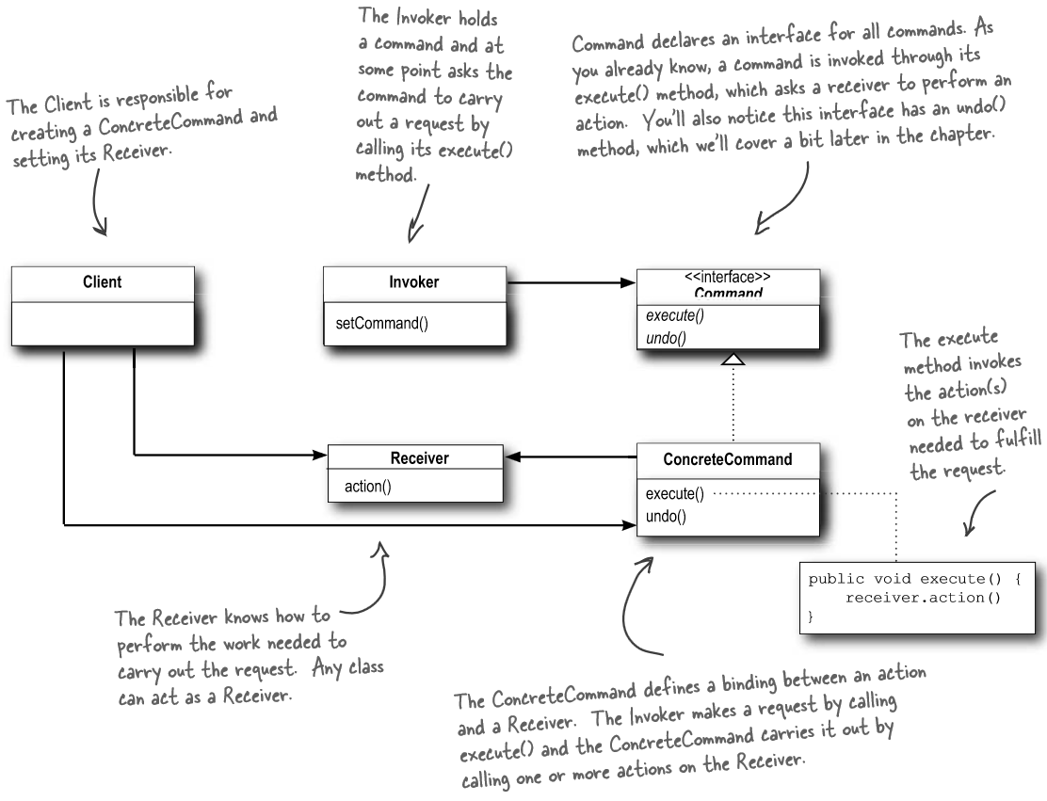
Command
Pattern

Slide 32
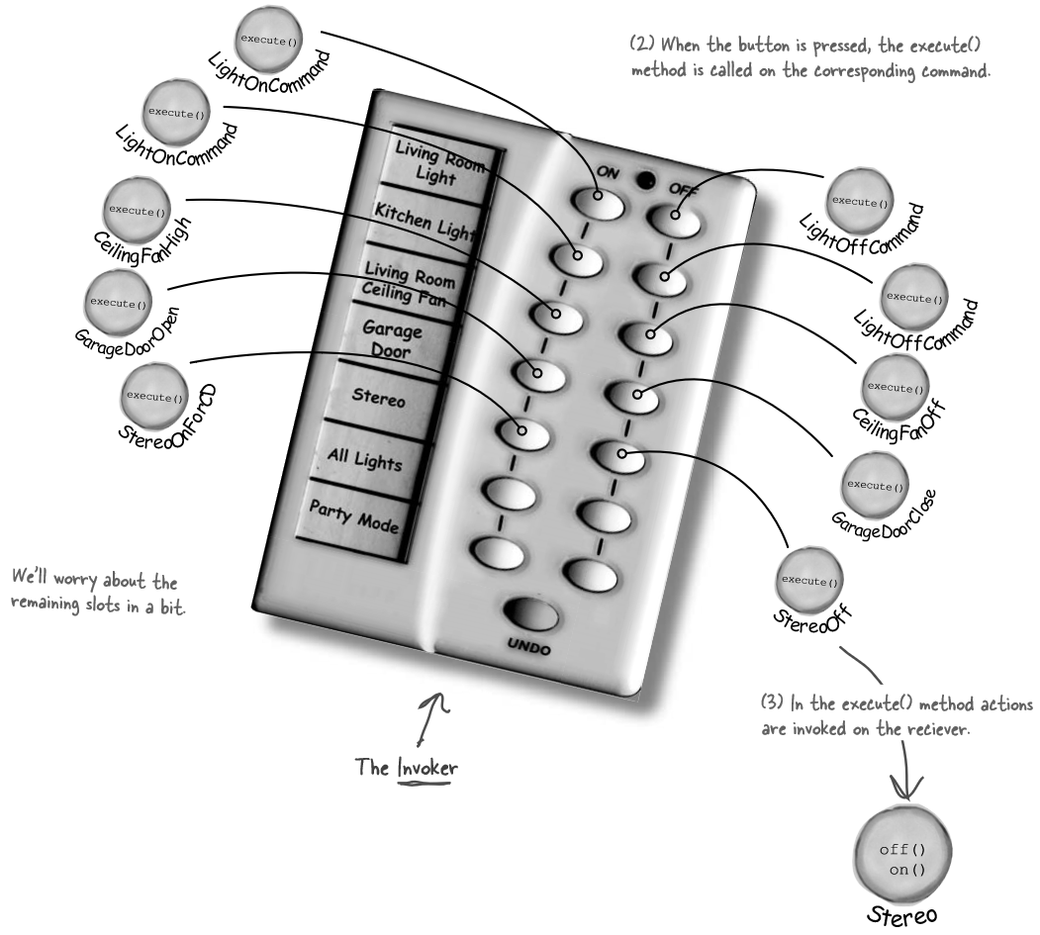
Remote
Control
Example

Slide 33
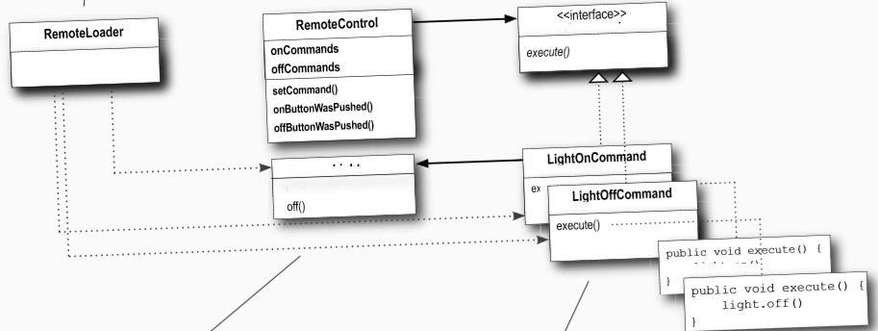
Remote
Control
Example
Light
on()

Slide 34
Adapter Pattern
Structural
Orlando Campos Pasten

Slide 35
Adapter pattern: Intent
Convert the interface of a class into another interface clients expect.
Adapter lets classes work together that couldn't otherwise because of incompatible interfaces.
Wrap an existing class with a new interface.
It helps to make an old component work in a new system.

Slide 36
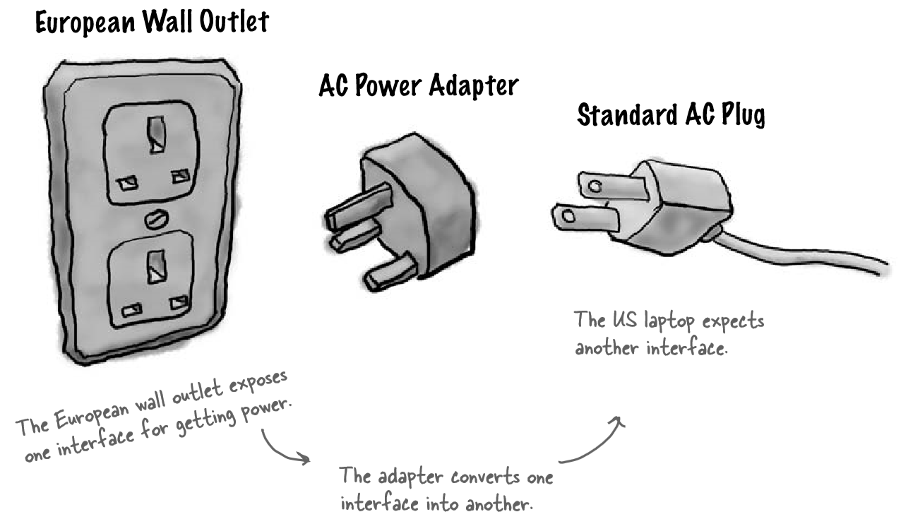
Adapter Pattern

Slide 37
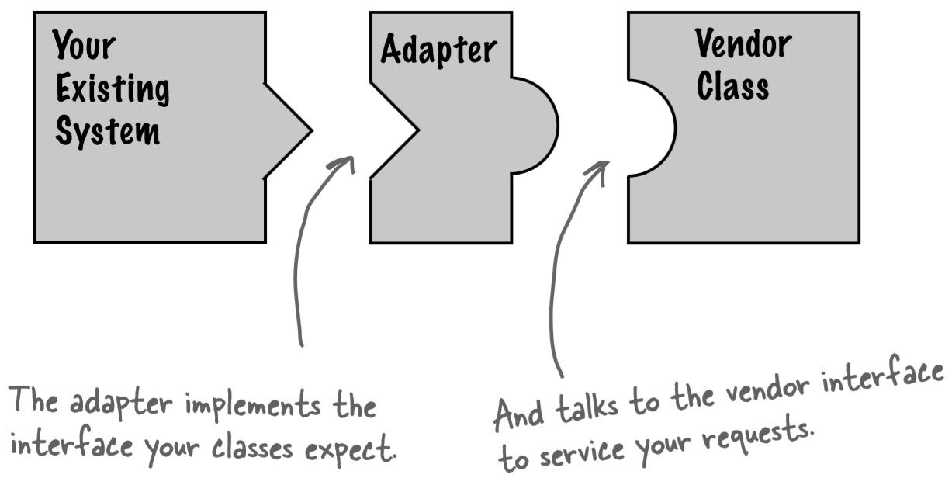
Adapter Pattern

Slide 38
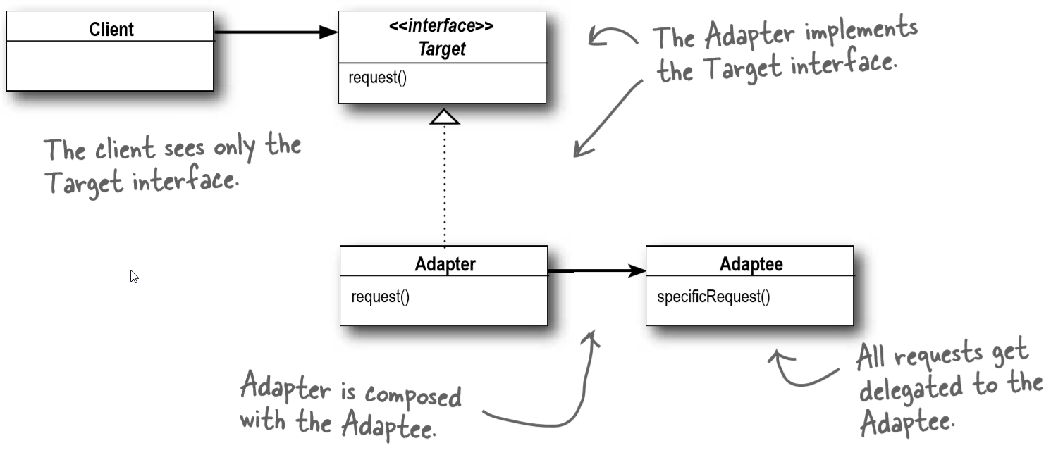
Adapter Pattern Class diagram

Slide 39
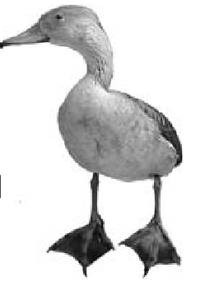
Adapter Pattern: Example
Si camina como un pato y grazna como un pato, entonces debe ser un pato...
Si camina como un pato y grazna como un pato, entonces puede ser un pavo envuelto en un adaptador para pato...
If it walks like a duck and quacks like a duck, then it must might be a duck turkey wrapped with a duck adapter...

